Slide 1

Tutorial: An introduction to QGIS
Aberdeen Study Group
Skill Sharing
Share your favorite coding skills and tools with your friends and colleagues in friendly, no-pressure work-alongs.
by Alicia Ledo
alicialedo@gmail.com

Slide 2
You can download QGIS here: http://www.qgis.org/en/site/
You can find help and documentation: http://www.qgis.org/en/docs/index.html
Cool screenshots of maps: https://www.flickr.com/groups/qgis/pool/

Slide 3
In this tutorial we will explore:
What is QGIS? What can I do with QGIS?
QGIS interface
QGIS FUNCTIONS and DATA EDIT
Functions for vector data
Functions for raster
The processing toolkit
Create/personalize maps
A list of free spatial data sources
--QGIS is a powerful and complex software. This tutorial is a basic introduction--

Slide 4
In this tutorial we will explore:
There will be some exercises. The slides explaining them have orange background
What is QGIS? What can I do with QGIS?
QGIS interface
QGIS FUNCTIONS and DATA EDIT
Functions for vector data
Functions for raster
The processing toolkit
Create/personalize maps
A list of free spatial data sources
--QGIS is a powerful and complex software. This tutorial is a basic introduction--

Slide 5
1. What’s QGIS?
It is a Free and Open Source Geographic Information System, licensed under the GNU General Public License. It is an official project of the Open Source Geospatial Foundation (OSGeo). Part of the Open Geospatial Consortium (OGC).
It was the free software alternative to ArcGIS. Now, QGIS is not only an alternative, it is the best available software. QGIS has more and more efficient geo-processing and map functions, which means, its faster than ArcGIS
GIS can analyse geometry, topology, and geographical and physical information all together.
Note: Please, bear in mind that GIS software is not part of my main research, I am only a user, and not even an advanced one

Slide 6
1. What’s QGIS?
It handles different kinds of map and image files:
Vector layers (i.e shapefiles),
Grid and raster layer (i.e. GEOTIFF),
Images (i.e. JPEG),
Remote sense images (i.e. LANDSAT) and Lidar
text data
large databases (i.e PostgreSQL), and
online data (i.e. OpenSteetMap).
QGIS also includes data!
More info about development, developers and philosophy can be found in the web: http://www.qgis.org/en/site/about/index.html

Slide 7
What can I do with QGIS?
Work with georeferenced data: read, visualize, process
Create, modify, import, export spatial data (vector and raster)
Analysis of spatial data, spatial analysis with georeferenced and geographical data and many kinds of geoprocessing
Batch work and programming with spatial data
Cool maps and videos
Be part of an exciting GIS open source community
among others!

Slide 8
QGIS built-ings
It has the QGIS main core, and then really interesting plug-ins (developed by the QGIS or other people) – like R and the packages
It also incorporates other GIS software inside: i.e GRASS and SAGA
You can code your own stuff – in Python and C++ (not in odd and old languages)
You can download your data from the server, and even processing online data (I’ve never used this, so I am afraid I cannot help much)
Please, bear in mind that some functions may be duplicated
New and exciting functions and plug-ins are appearing!

Slide 9
QGIS built-ings
It has the QGIS main core, and then really interesting plug-ins (developed by the QGIS or other people)
It also incorporates other GIS software inside: i.e GRASS and SAGA
You can code your own stuff – in Python and C++ (not in odd and old languages)
You can download your data from the server, and even processing online data
Please, bear in mind that some functions may be duplicated
New and exciting functions and plug-ins are appearing!

Slide 10
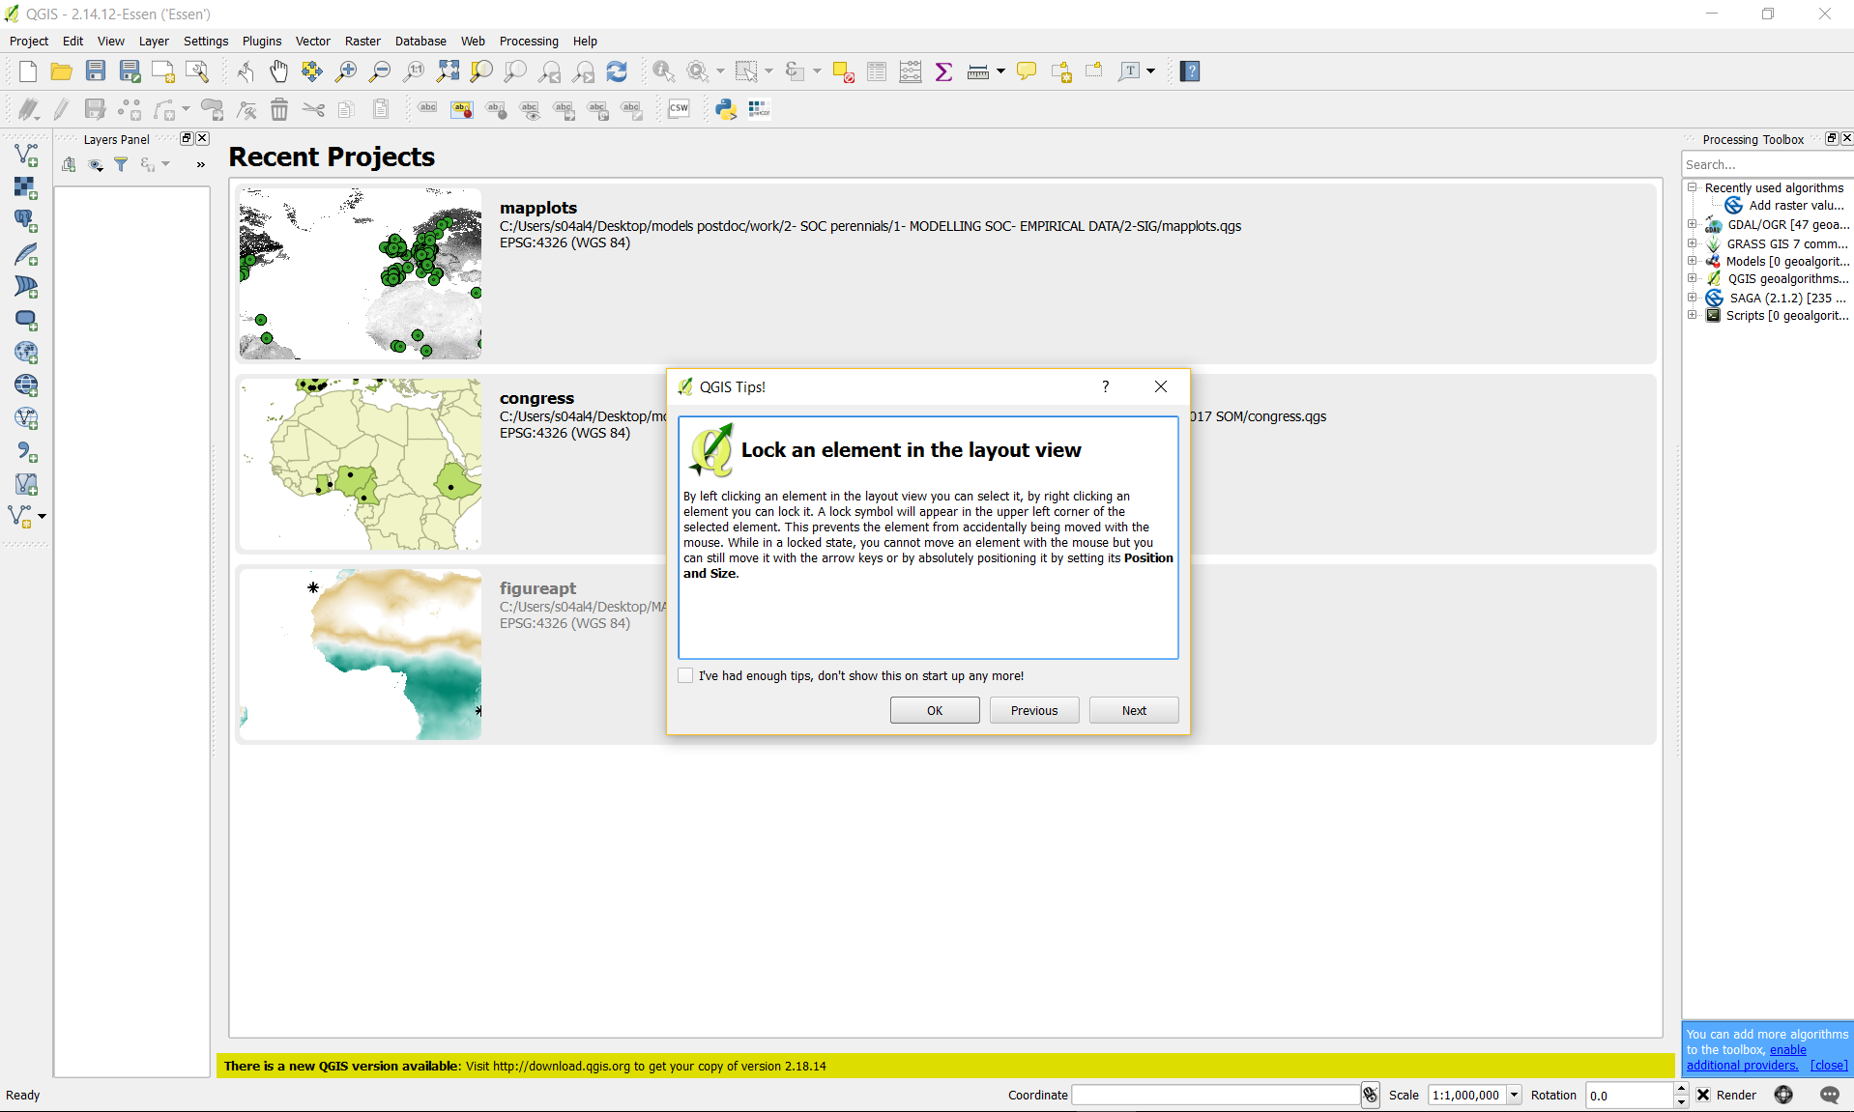
2. QGIS interface
When you open QGIS you will see the last projects you worked on, and a tip - You’ll have new tips any time, and access to projects you have opened recently
Note: When working with GIS is essential to have the data in a projection coordinates reference systems (CSR). We are going to use the by-default one in this tutorial, since explaining CSR systems is far beyond this tutorial – but please bear in mind it is essential to know your CSR!!

Slide 11
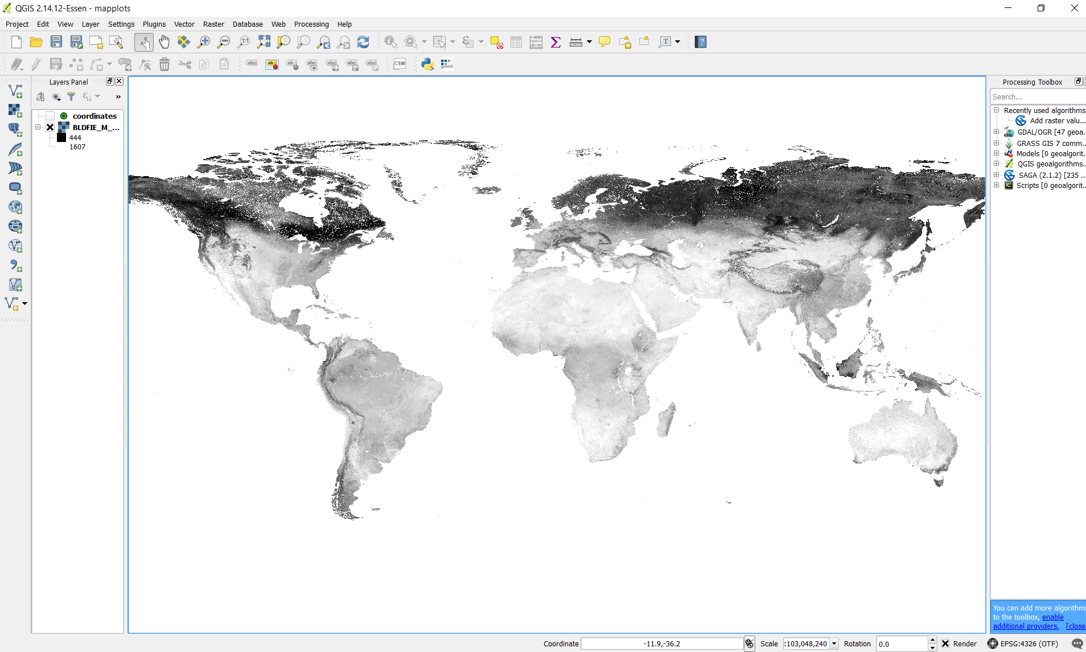
Menu bar
Tools bar
Layers panel
Processing tools bar
Opens different layers
Geographic information

Slide 12
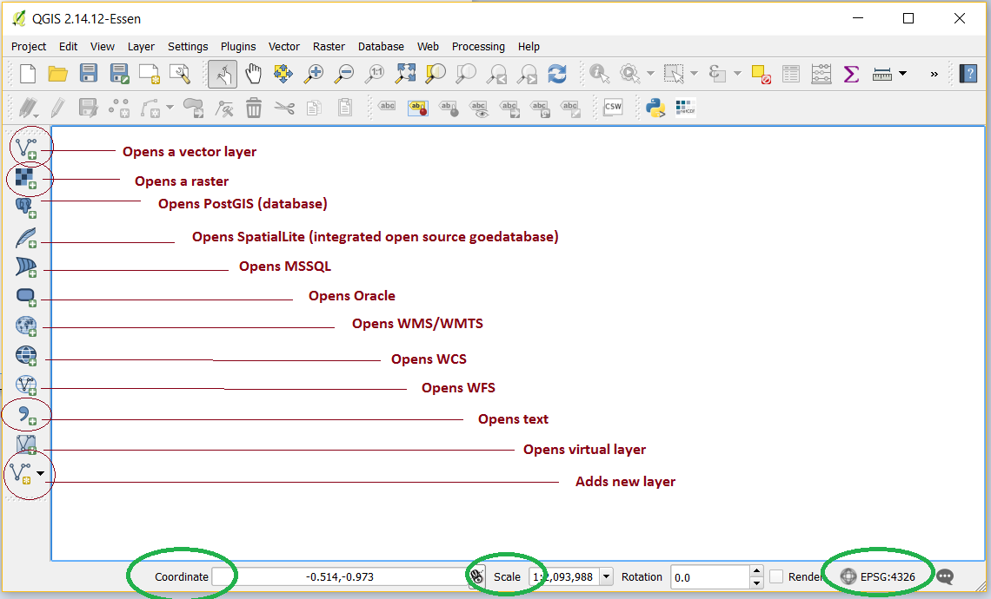
First step: open data
Note: main formats for spatial data (1) raster, (2) vector (lines, polygons, points) and (3) text

Slide 13
Using QGIS…
You can either use the friendly-windows clicking icons or write your codes - but I am not going to present this in the present tutorial
QGIS communicates with GRASS, R, Python and other free software
QGIS has direct access to online databases
You can also write down your own programs, scripts and algorithms, i.e. to do a bath work (I recommend using the Python console)
You can also write new applications in C++ and Python (that’s beyond my knowledge)

Slide 14
Practise 1: VISUALISING DATA
Open QGIS
Open a new project (Project/New)
Save your project (Project/save as)
Open the map of global precipitation in January (mm) – this file is prec1. It is a grid
Open the coordinates. A text file

Slide 15
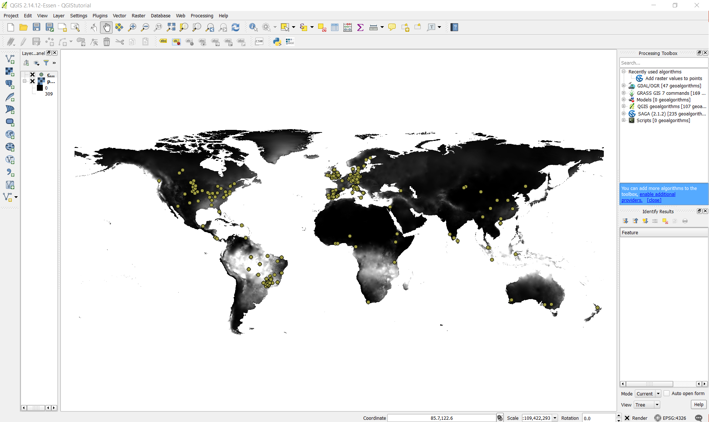

Slide 16
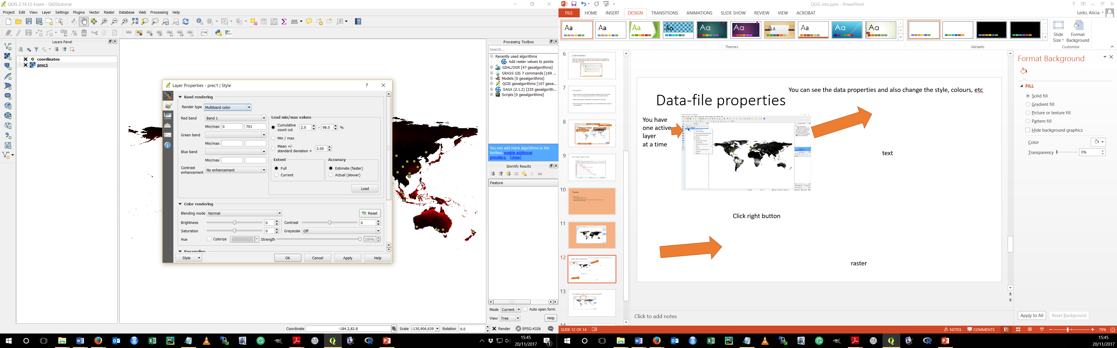
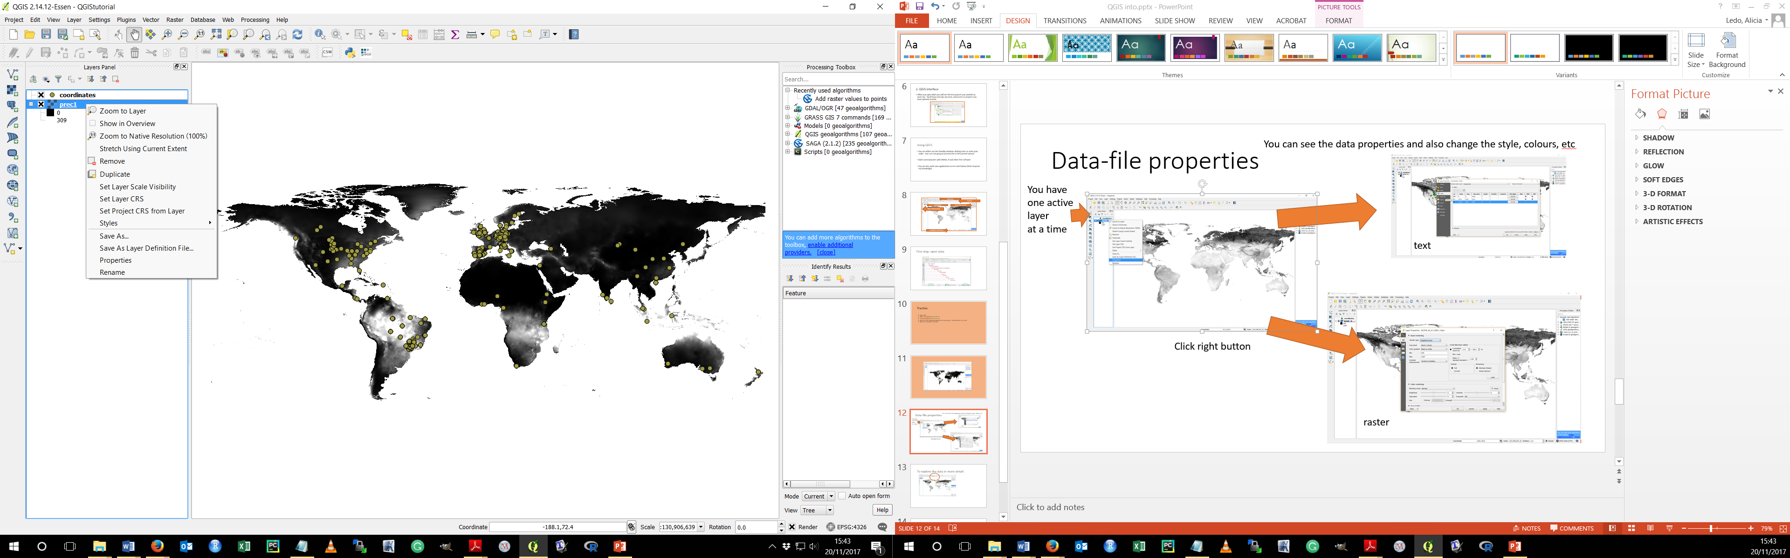
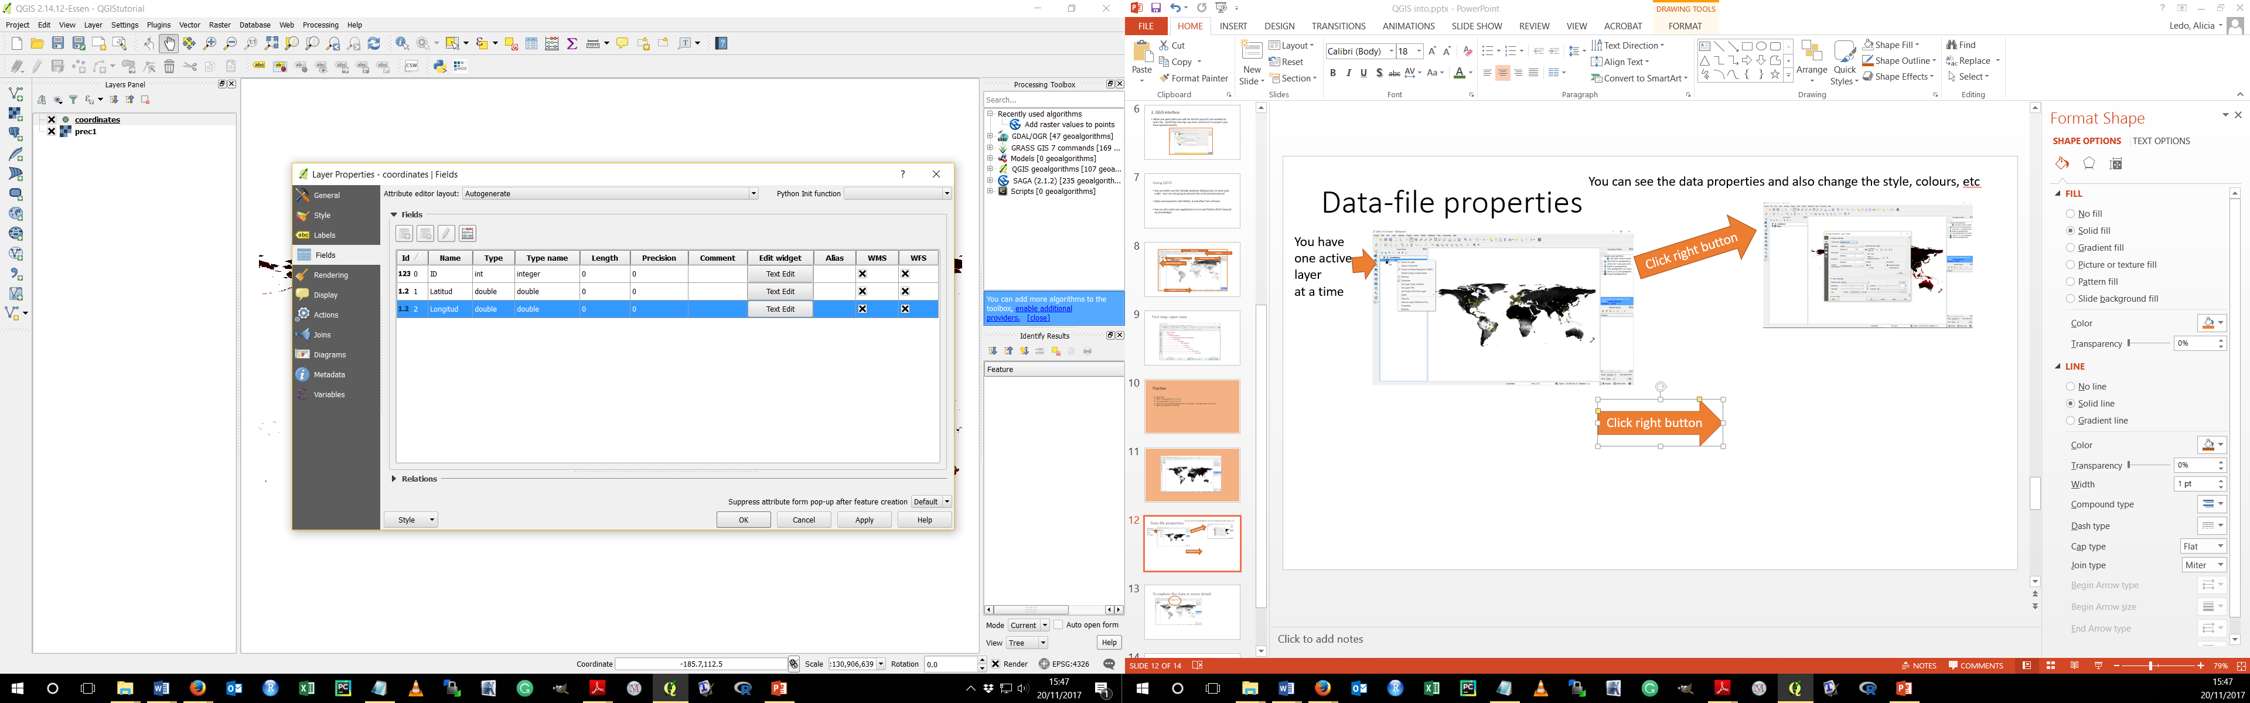
Check Data-file properties
Click right button
You have
one active
layer
at a time
Click right button

Slide 17
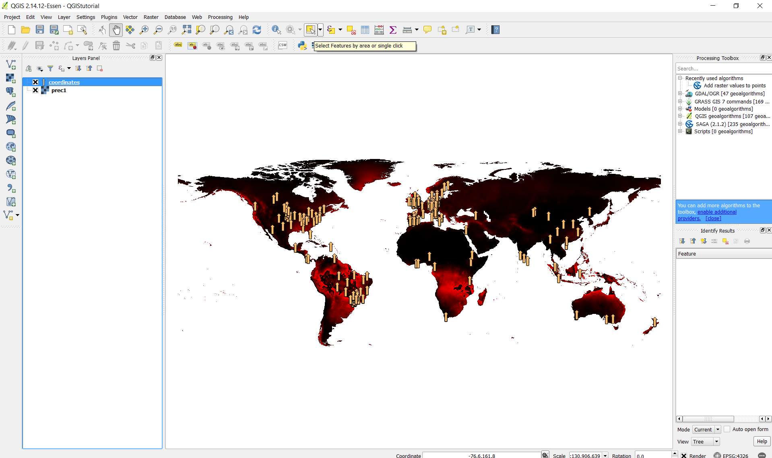
To explore the data in more detail:

Slide 18
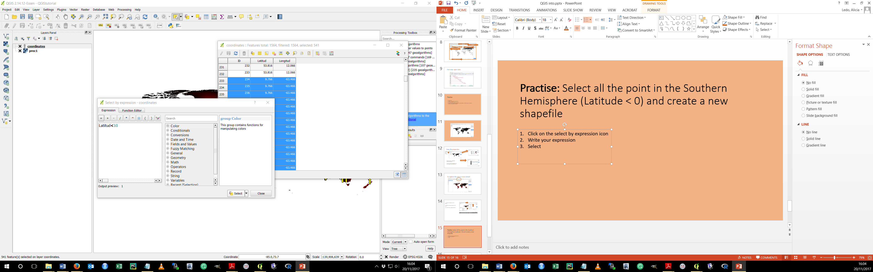
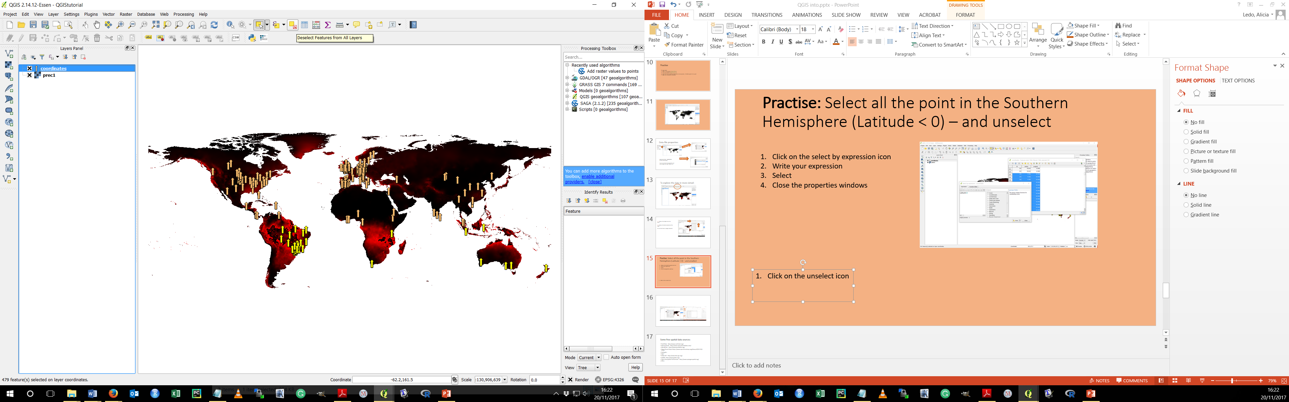
SELECT SPATIAL DATA BY ATTRIBUTES
GOAL: Select all the point in the Southern Hemisphere (Latitude < 0)
Open the table attributes of coordinates
Click on the select by expression icon
Write your expression (Latitude < 0)
Select
Close the properties windows
Click on the Deselect icon

Slide 19
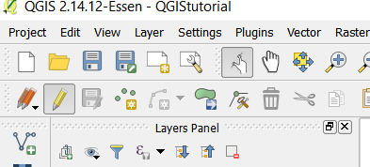
3. QGIS FUNCTIONS and DATA EDIT
Data layers can be edited within the QGIS desktop

Slide 20
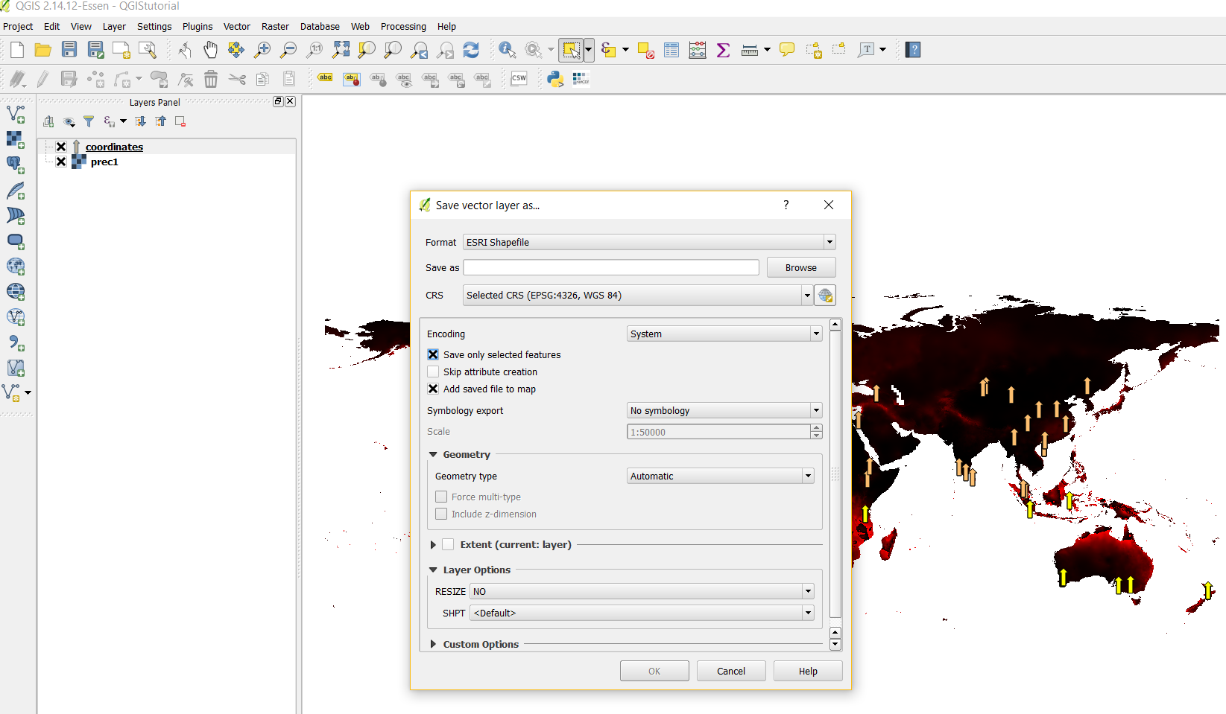
Practise: CREATE A NEW SHAPEFILE
GOAL: Create a new shapefile containing only plots in the southern hemisphere
Select points in the south hemisphere
(we have done this in the previous slide)
Click layer/ save as
Make sure you click the save only selected feature
Ok
1
2
You have created a new shape field!

Slide 21
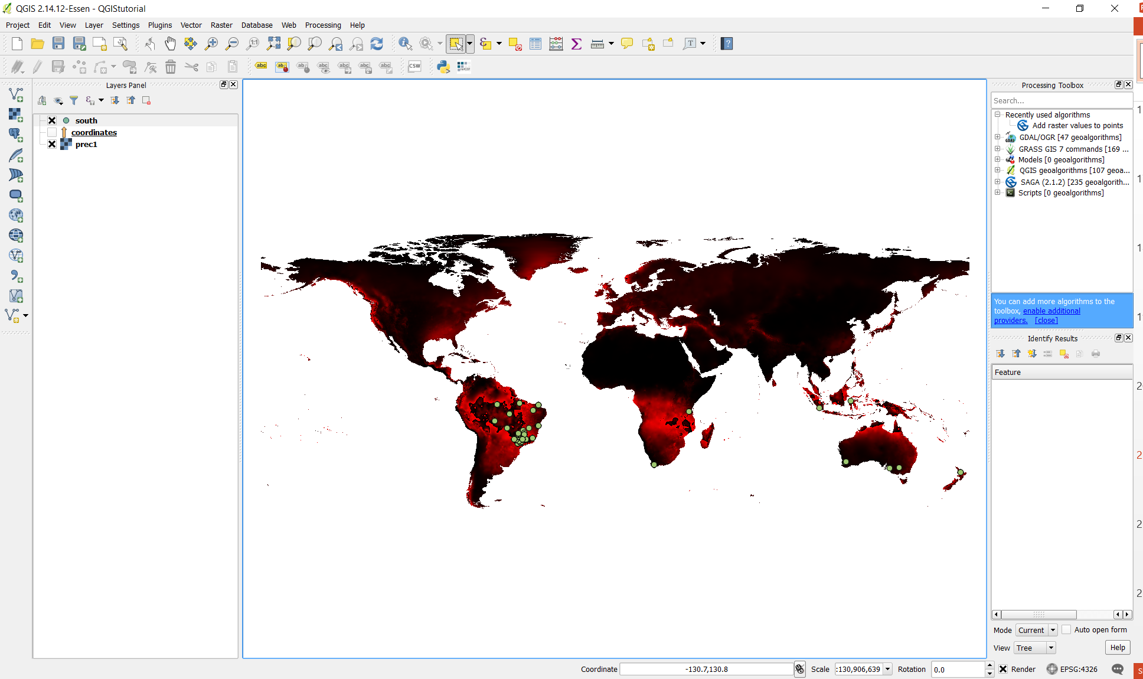
Practise: Create a new shapefile by selecting attributes – points in the southern hemisphere
Open attribute table
Select the point in the south (Latitude<0)
In the main menu, click layer/ save as
Make sure you click the save only selected feature
Name your new file as “south”
Ok
Deselect the points in the coordinate table
Make your new “south” layer active
Change the colours of your points and style your shapefile as you like
You can deselect the visualization of the coordinates layer
WE have done that in the previous slide

Slide 22
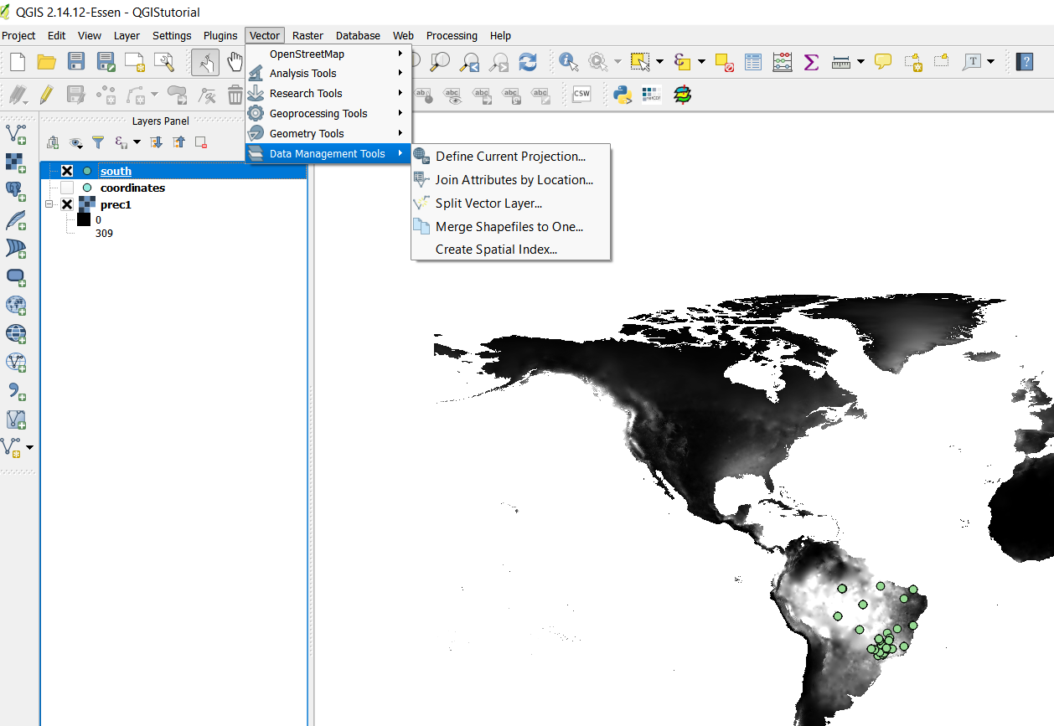
Functions for data vector:
Merge shapefiles
Re-shape
Spatial calculations (i.e. buffer)
Create new shapefiles
Calculate areas
All these spatial analysis functions are in the vector section. Extra functions can be added by adding new plug-ins

Slide 23
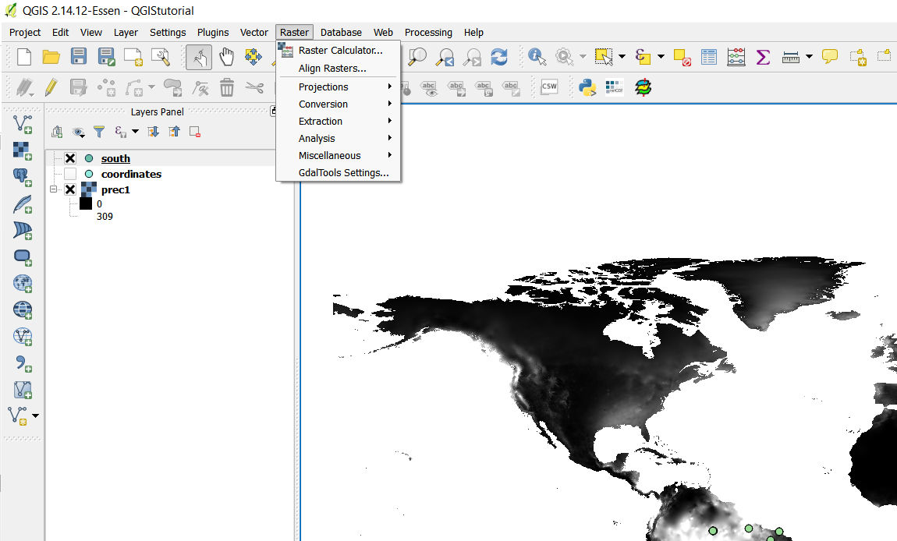
Functions for raster vector:
Sampling, re-sampling
Extract information
Reclassification
Create mosaiques
Spatial calculations (using information from one or more Rasters)
Spatial interpolation
Convert Raster to vector
As for the vectors, all these spatial analysis functions are in the raster section. Extra functions can be added by adding new plug-ins

Slide 24
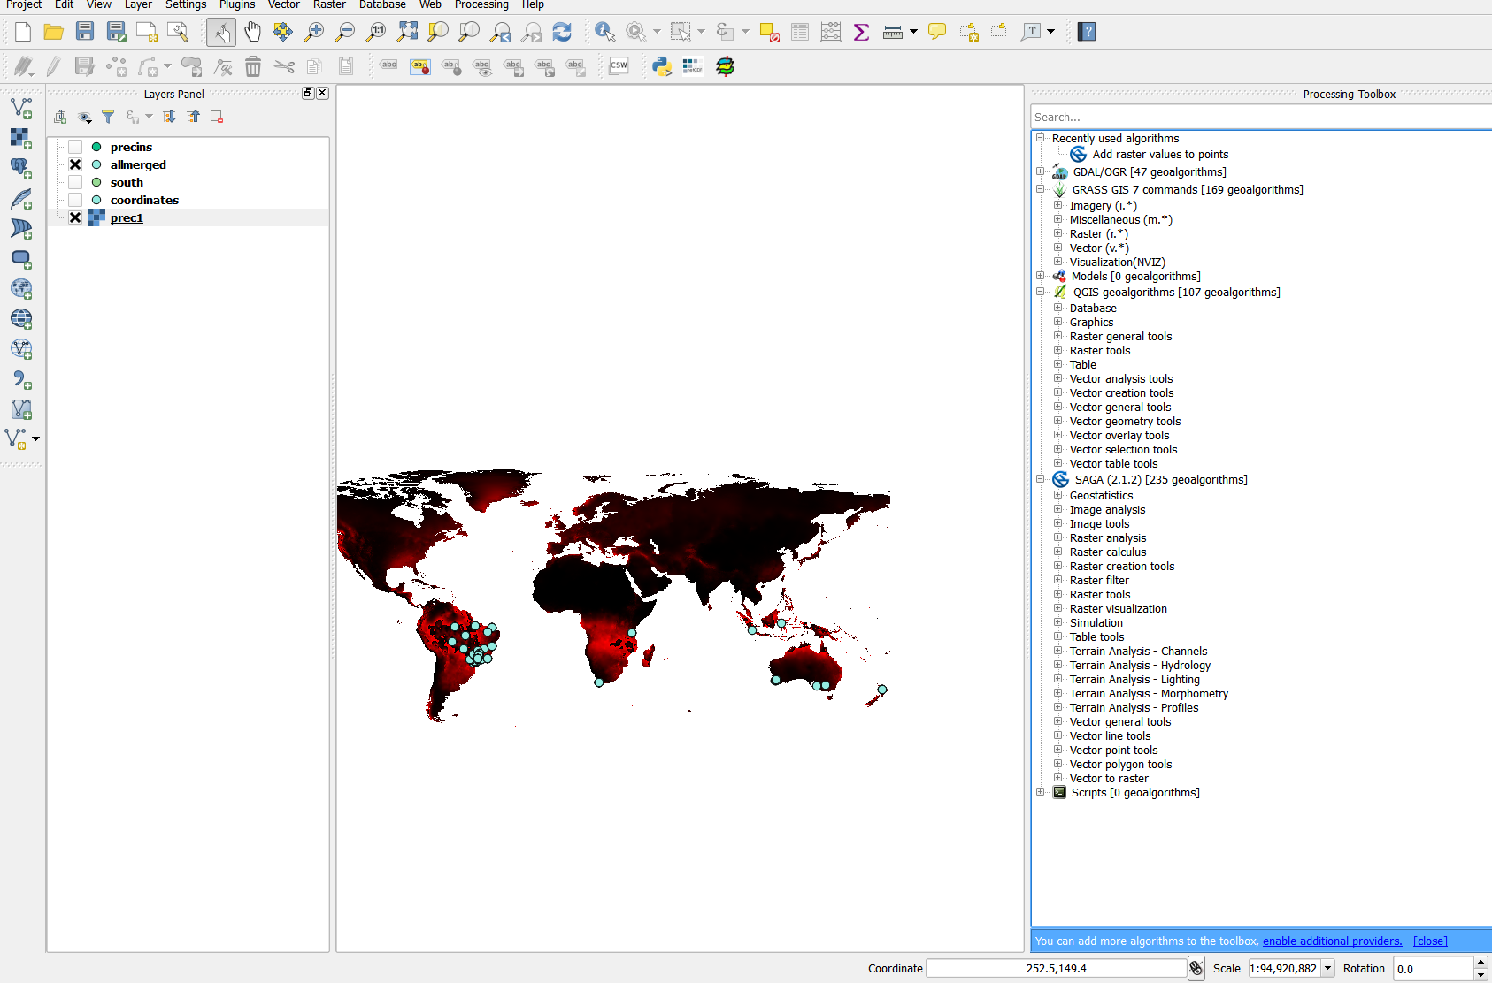
The processing toolbox
Here you can find the GRASS, SAGA and other algorithms
(Processing/toolbox)

Slide 25
Practise: Adding the value of precipitation to the south plot data
Oh, no, I cannot find that function in the main menu!
Nae worries, Most of the functions have been already coded.
There are (at least) two easy ways of doing this:
1) adding a plug-in
2) using SAGA

Slide 26
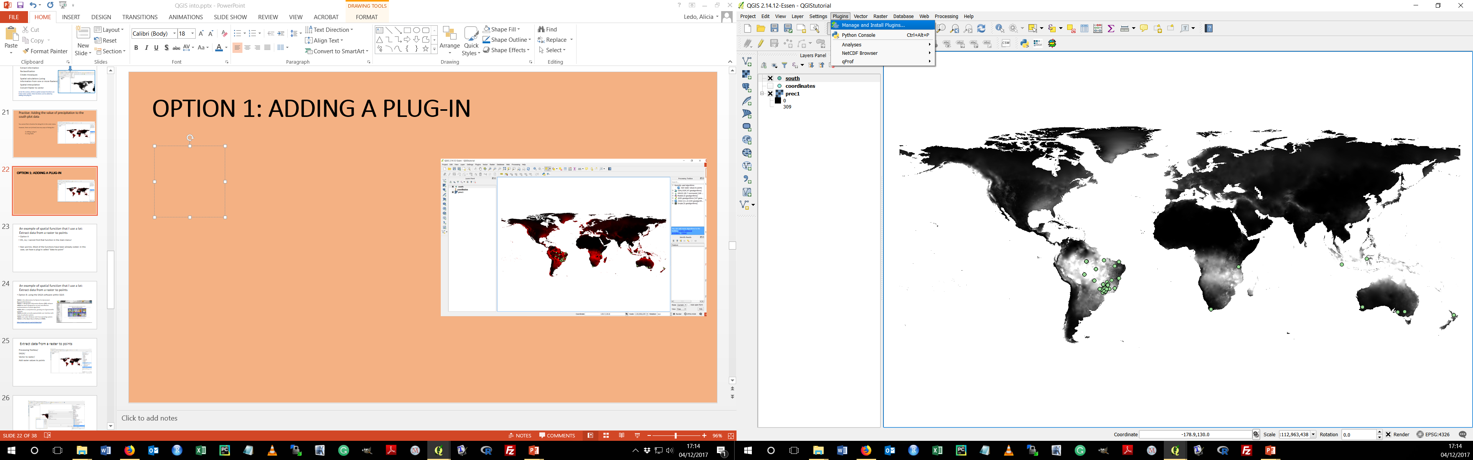
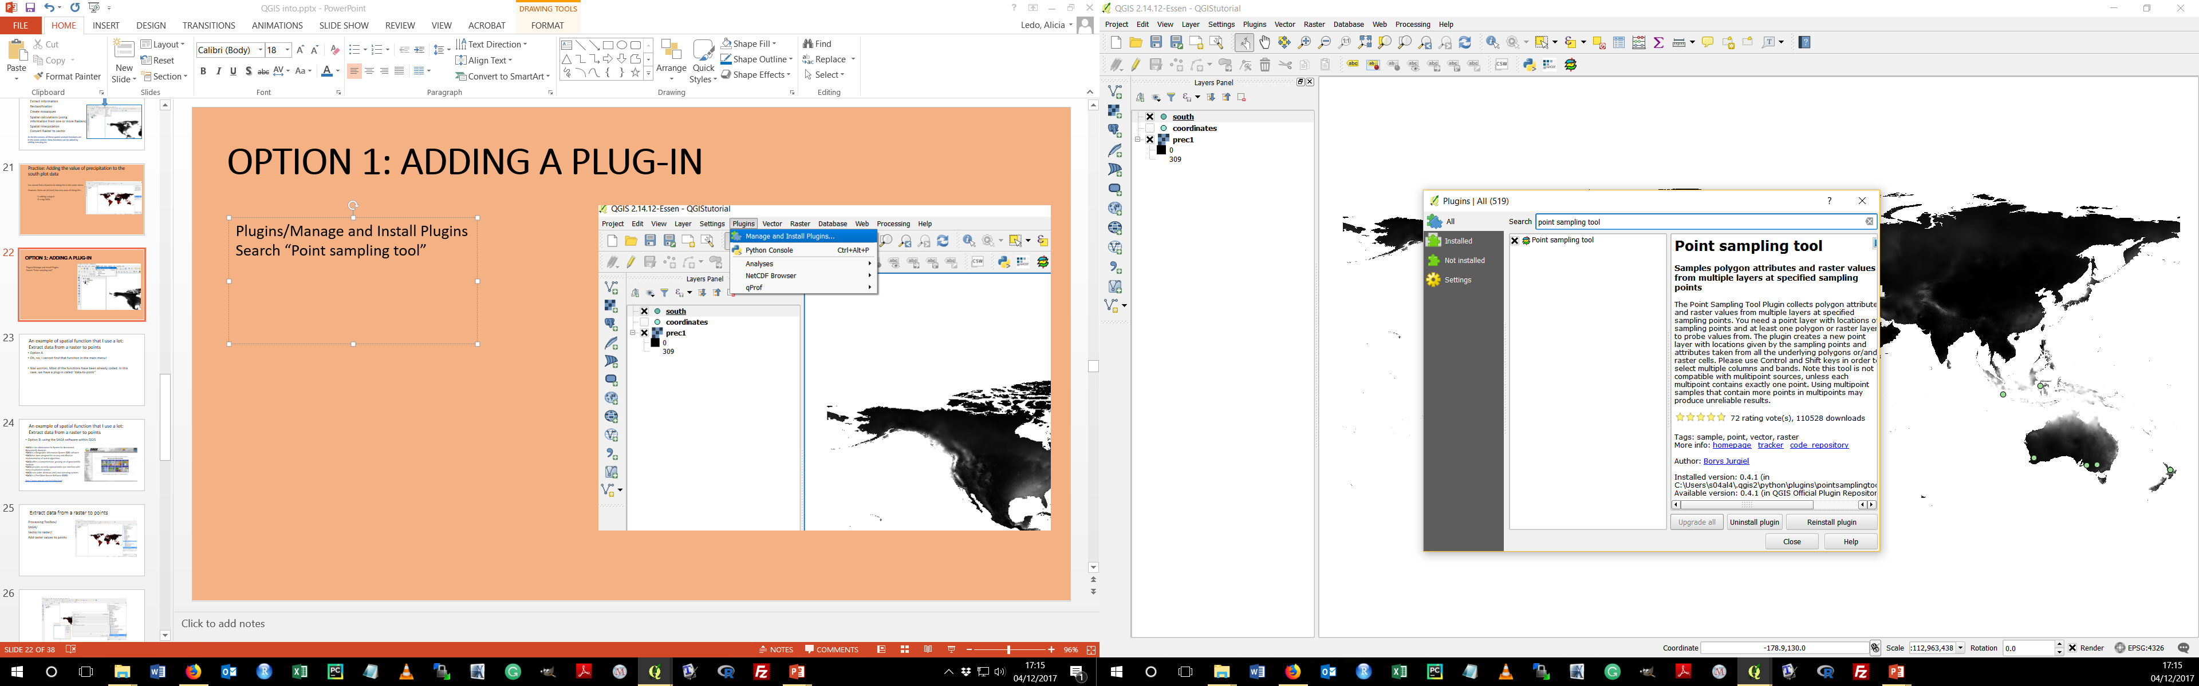
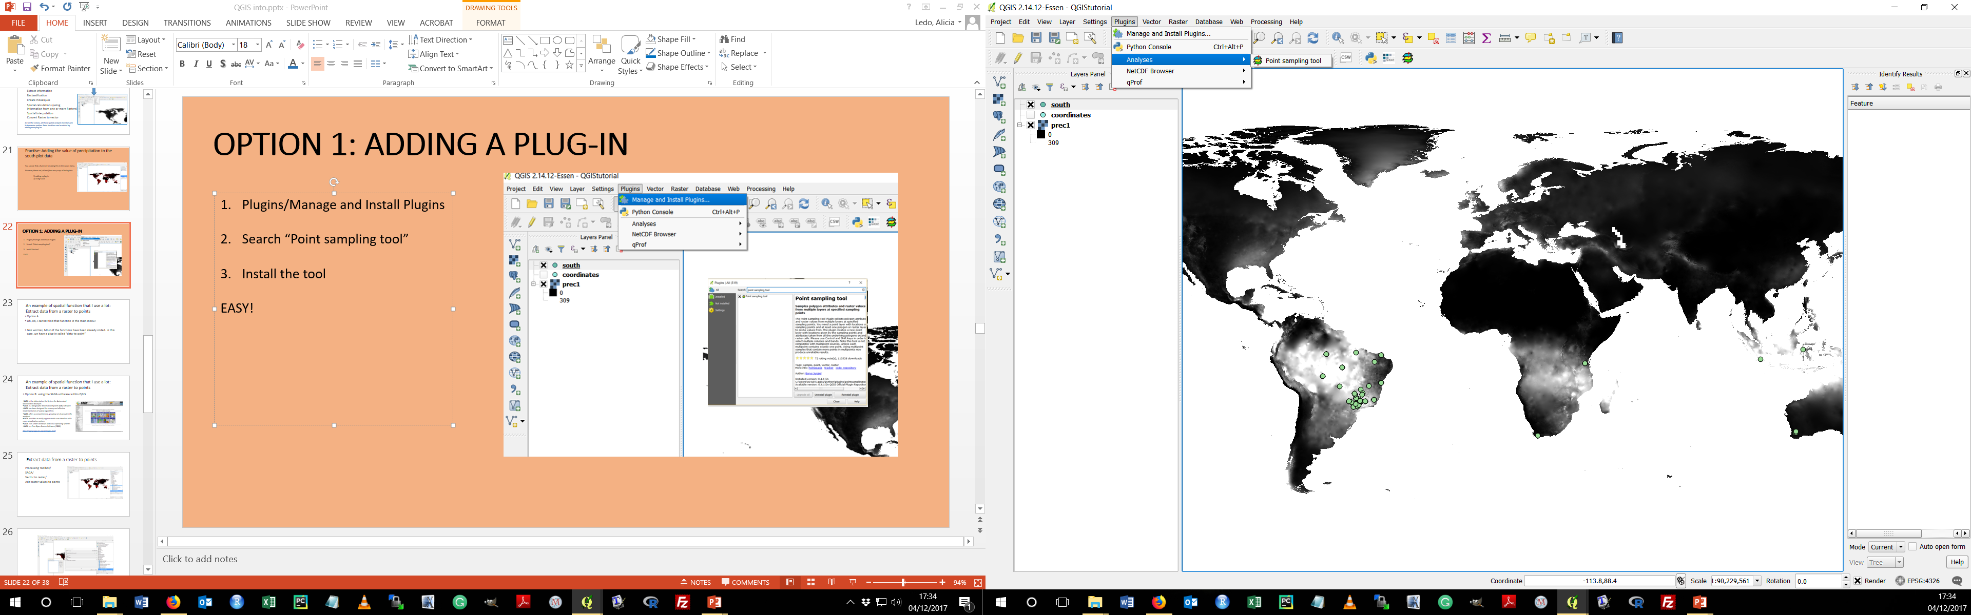
OPTION 1: ADDING A PLUG-IN
Plugins/Manage and Install Plugins
Search “Point sampling tool”
Install the tool
EASY!
4. You can now see the plugin:

Slide 27
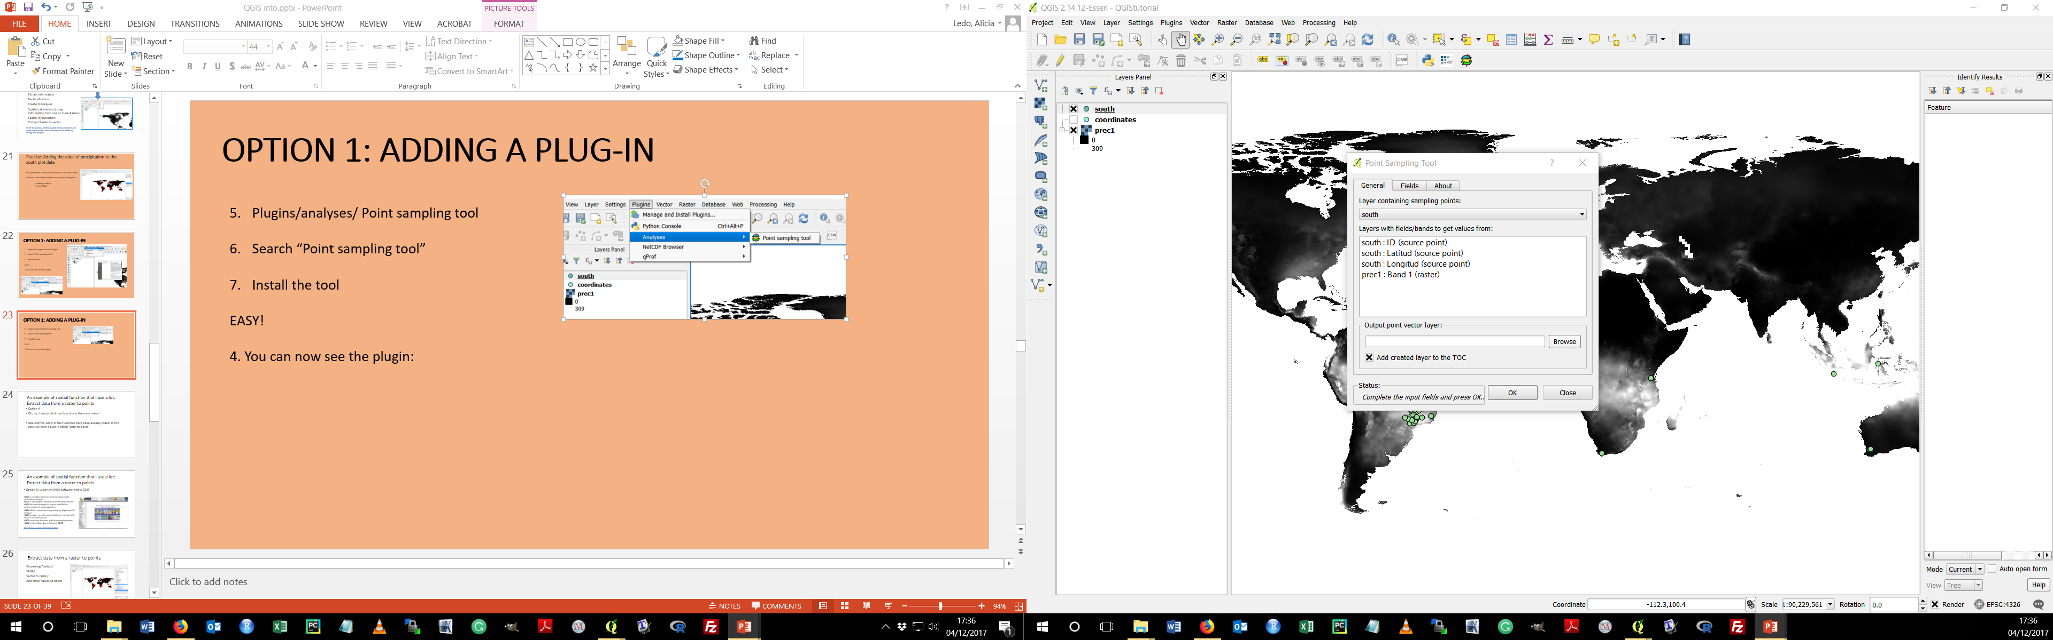
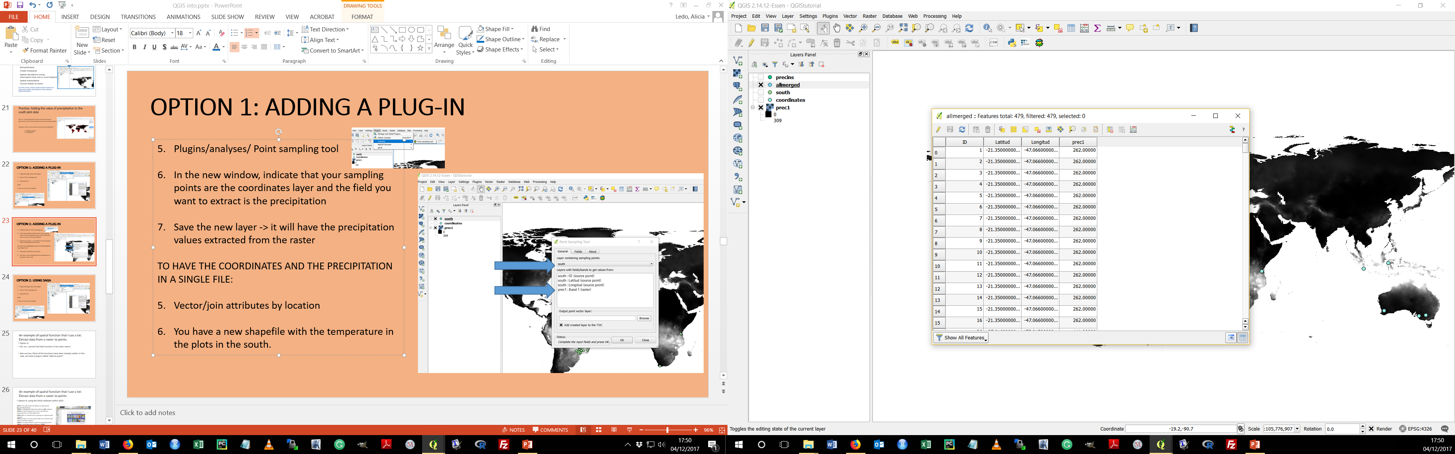
OPTION 1: ADDING A PLUG-IN
Plugins/analyses/ Point sampling tool
In the new window, indicate that your sampling points are the coordinates layer and the field you want to extract is the precipitation
Save the new layer -> it will have the precipitation values extracted from the raster
TO HAVE THE COORDINATES AND THE PRECIPITATION IN A SINGLE FILE:
Vector/join attributes by location
You have a new shapefile with the temperature in the plots in the south (you can open the attribute table and check it).

Slide 28
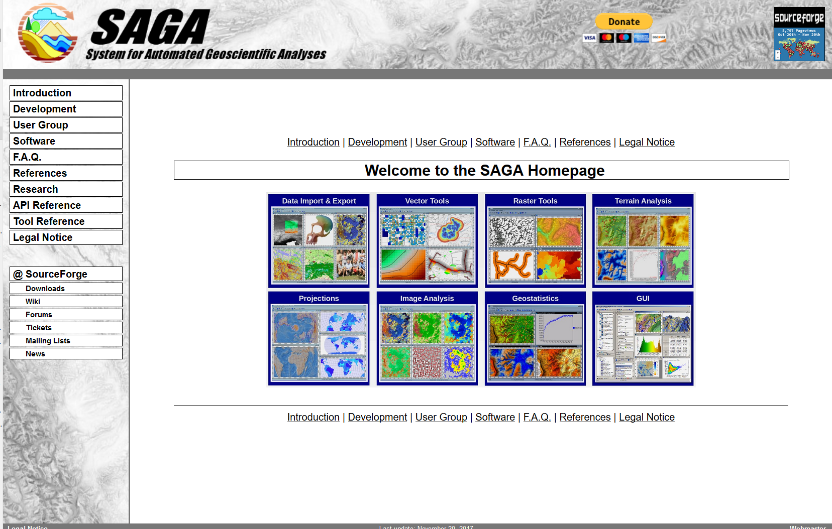
OPTION 2: USING SAGA
SAGA is the abbreviation for System for Automated Geoscientific Analyses
SAGA is a Geographic Information System (GIS) software
SAGA has been designed for an easy and effective implementation of spatial algorithms
SAGA offers a comprehensive, growing set of geoscientific methods
SAGA provides an easily approachable user interface with many visualisation options
SAGA runs under Windows and Linux operating systems
SAGA is a Free Open Source Software (FOSS)
http://www.saga-gis.org/en/index.html

Slide 29
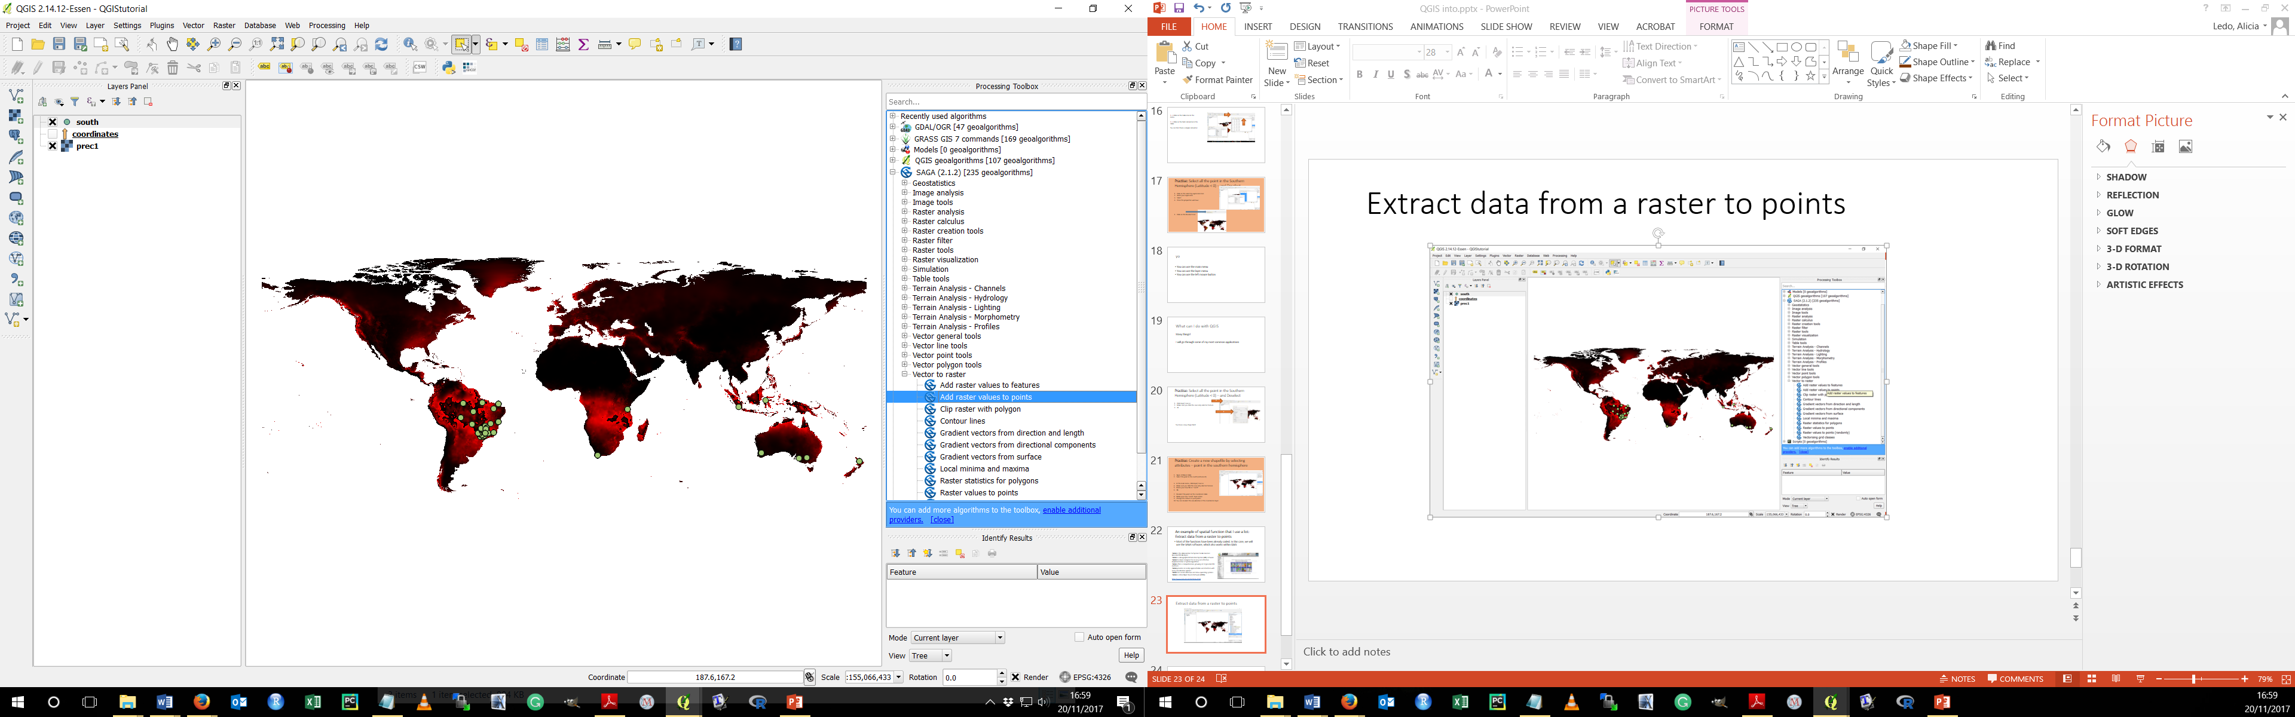
Extract data from a raster to points
Processing Toolbox/
SAGA/
Vector to raster/
Add raster values to points

Slide 30
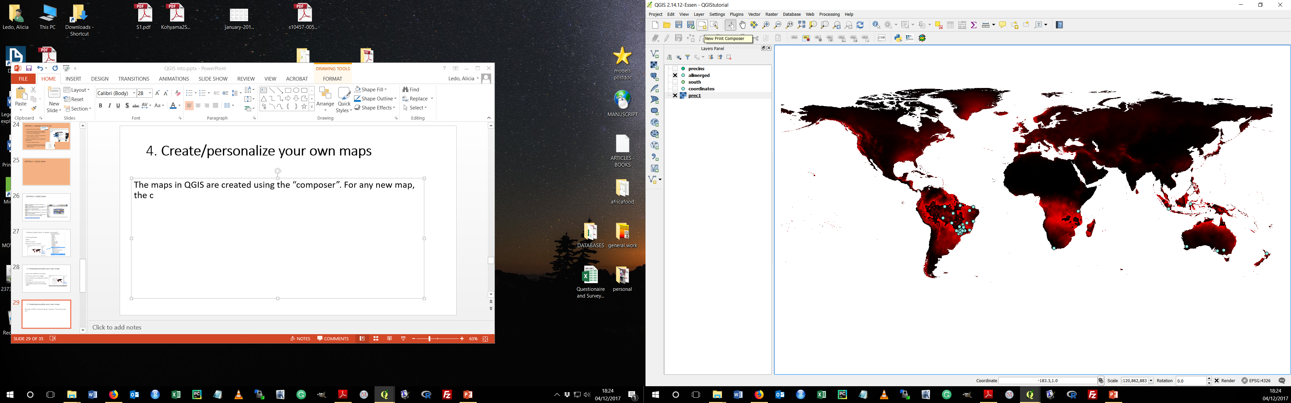
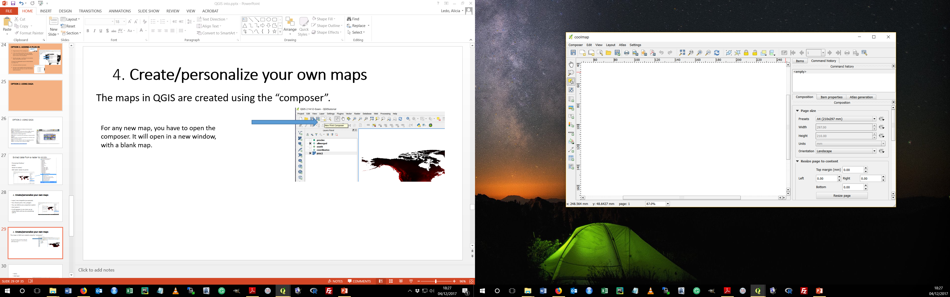
4. Create/personalize your own maps
The maps in QGIS are created using the “composer”.
For any new map, you have to open the composer. It will open in a new window, with a blank map.

Slide 31
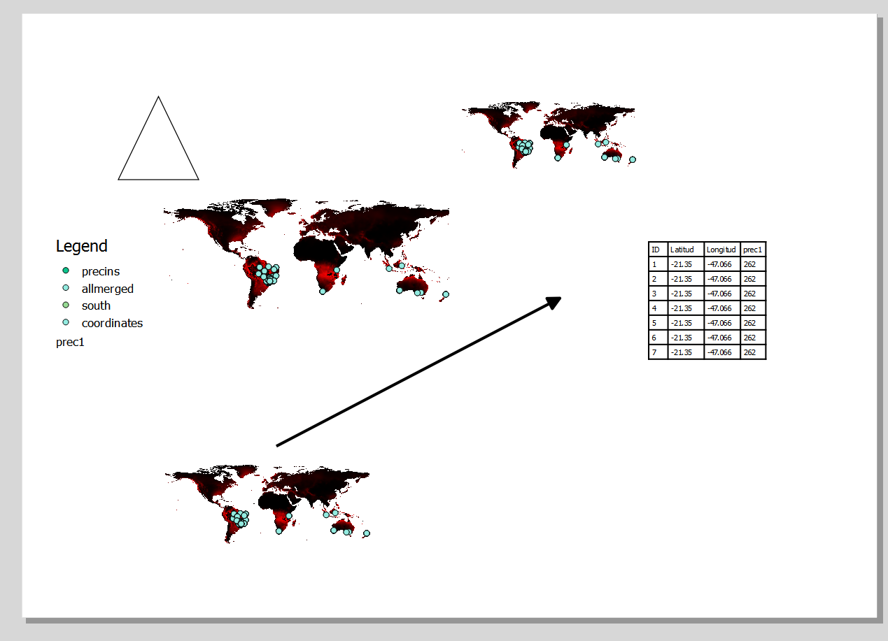
composer
In that new window, you can add all the features you want to have in your map. The easiest way is clicking on the feature you want to add in the left menu and then clicking on the screen composer to “draw” it.
Adds the map you have in the QGIS main screen
Adds legend
Adds header of your data

Slide 32
Open the composer and play around

Slide 33
Export your map :)

Slide 34
Some free spatial data sources:
EarthStat - http://www.earthstat.org/
Natural Earth - http://www.naturalearthdata.com/
WorldClim - http://www.worldclim.org/
Open Street Maps https://www.openstreetmap.org/#map=6/54.910/-3.432
WorldGrids -http://worldgrids.org/doku.php/source_data
DIVA-GIS - http://www.diva-gis.org/
GADM- http://www.gadm.org/
Open Geospatial Consortium - http://www.opengeospatial.org/

Slide 35
Some free spatial data sources:
WORLDGRIDS http://worldgrids.org/doku.php/source_data#other_sources_of_global_environmental_lay
This page contains a categorised list of links to over 300 sites providing freely available geographic datasets - all ready for loading into a Geographic Information System:
http://freegisdata.rtwilson.com/
ETC!!

Slide 36
Thank you very much, I hope you have managed to get to know QGIS a bit
Aberdeen Study Group
Skill Sharing
Share your favorite coding skills and tools with your friends and colleagues in friendly, no-pressure work-alongs.

